Slide 1
XSLT
eXtensible Stylesheet Language Transformations
Notes:
https://www.youtube.com/watch?v=0It-kBg-7NE

Slide 2
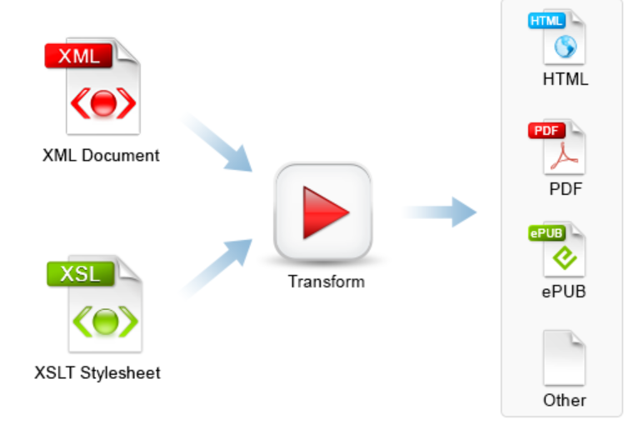
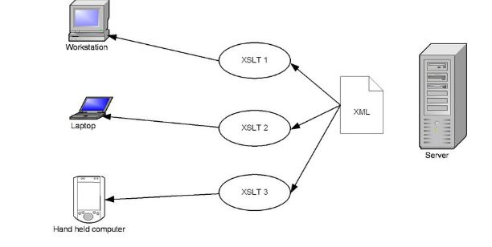

Slide 3
XSL (eXtensible Stylesheet Language)
In case of HTML document, tags are predefined such as table, div, and span; and the browser knows how to add style to them and display those using CSS styles.
But in case of XML documents, tags are not predefined.
XSL provide formatting for XML.
XSL is the intermediary between XML elements and the browser.
An XSL file is a style sheet that can be used to transform XML documents into other document types and to format the output.

Slide 4
XSL (Cont …)
Since the XML language does not use predefined tags, it is necessary to provide the web browser with information on how to interpret the XML document.
The XSL document provides the browser with information on how to display an XML document.
XSL gives a developer the tools to describe exactly which data fields in an XML file to display and exactly where and how to display them.

Slide 5
Main parts of XSL
XSLT − used to transform XML document into various other types of document.
This language takes existing XML documents and transform them into other XML documents.

Slide 6
XPath
Used to navigate XML document.
XPath language defines parts of XML document.
This allows XML authors to link to very specific locations within an XML document.
It is an expression language used by XSLT to access or refer to parts of an XML document.

Slide 7
XSL-FO
It is Extensible Stylesheet Language Formatting Objects.
It focuses on style that works for both screen and print, such as PDF files.
Used to format XML document.

Slide 8
XSLT
XSLT, Extensible Stylesheet Language Transformations, provides the ability to transform XML data from one format to another automatically.
With XSLT we can add/remove elements and attributes to or from the output file.
You can also rearrange and sort elements, perform tests and make decisions about which elements to hide and display, and a lot more.

Slide 9
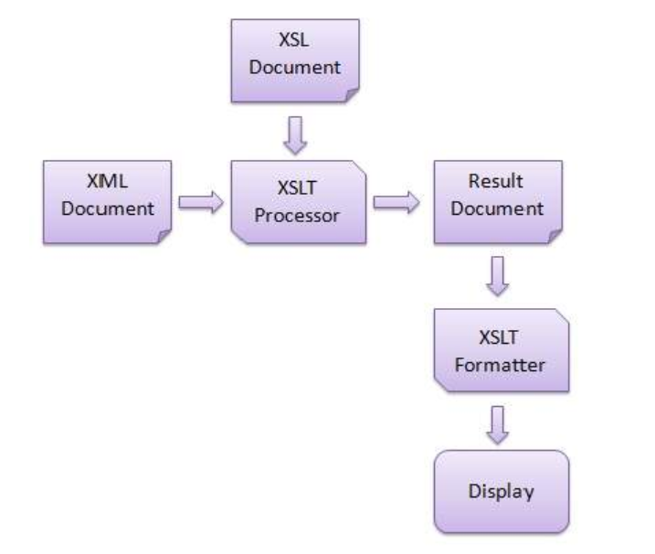
How XSLT Works

Slide 10
An XSLT stylesheet is used to define the transformation rules to be applied on the target XML document.
XSLT stylesheet is written in XML format.
XSLT Processor takes the XSLT stylesheet and applies the transformation rules on the target XML document and then it generates a formatted document in the form of XML, HTML, or text format.
This formatted document is then utilized by XSLT formatter to generate the actual output which is to be displayed to the end-user.

Slide 11
Advantage of XSLT
XSLT provides an easy way to merge XML data into presentation because it applies user defined transformations to an XML document and the output can be HTML, XML, or any other structured document.
XSLT provides Xpath to locate elements/attribute within an XML document.

Slide 12
Cont…
By using XML and XSLT, the application UI script will look clean and will be easier to maintain.
XSLT templates are based on XPath pattern which is very powerful in terms of performance to process the XML document.
XSLT can be used as a validation language as it uses tree-pattern-matching approach.
You can change the output simply modifying the transformations in XSL files.

Slide 13
Declaration of xml-stylesheet
<?xml-stylesheet type=“text/xsl” href=“class.xsl” ?>
where,
type: type of file being linked to. For that text/xsl values can be
used.
href: the location of the file.

Slide 14
<xsl:template> Element
XSLT style sheet consist of a set of rules that are called templates.
Each template “matches” some set of elements in source tree and then describes the contribution that the matched element makes to result tree.
A template contains rules to apply when a specified node is matched.
The <xsl:template> element is used to build templates.
The match attribute is used to associate a template with an XML element.
The match attribute can also be used to define a template for the entire XML document.
The value of the match attribute is an XPath expression (i.e. match="/" defines the whole document).

Slide 15
<xsl:value-of> Element
<xsl:value-of> tag puts the value of the selected node as per XPath expression, as text.
Declaration
<xsl:value-of select = Expression>

Slide 16
XSLT <for-each>
<xsl:for-each> tag applies a template repeatedly for each node.
Declaration
<xsl:for-each select = Expression > </xsl:for-each>

Slide 17
XSLT <sort>
<xsl:sort> tag specifies a sort criteria on the nodes.
Declaration:
<xsl:sort
select = string-expression
data-type = { "text" | "number" | QName }
order = { "ascending" | "descending" }
case-order = { "upper-first" | "lower-first" } >
</xsl:sort>

Slide 18
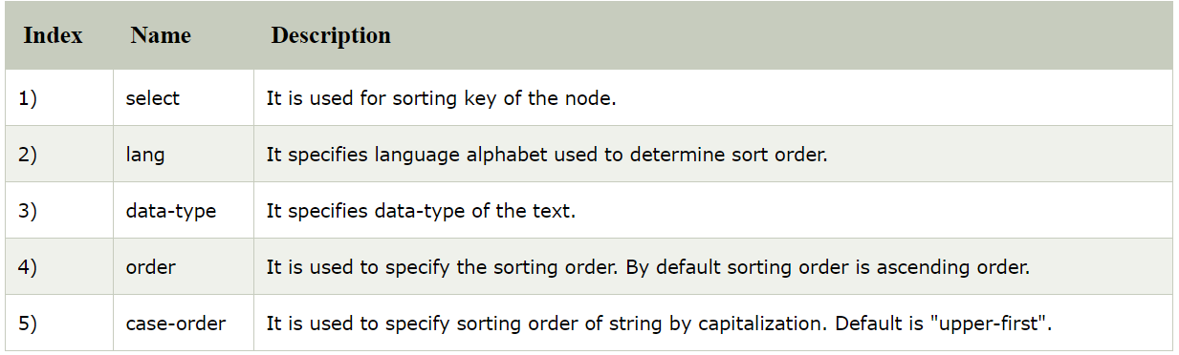

Slide 19
XSLT <xsl:if> Element
The XSLT <xsl:if> element is used to specify a conditional test against the content of the XML file.
<xsl:if test="expression">
...some output if the expression is true...
</xsl:if>

Slide 20
XSLT <choose>
<xsl:choose> tag specifies a multiple conditional tests against the content of nodes in conjunction with the <xsl:otherwise> and <xsl:when> elements.
Declaration
<xsl:choose > </xsl:choose>

Slide 21
XSLT <xsl:key>
The XSLT element is used to specify a named name-value pair assigned to a specific element in an XML document.
This key is used with the key() function in XPath expressions to access the assigned elements in an XML document.

Slide 22
Declaration
<xsl:key
name = QName
match = Pattern
use = Expression>
</xsl:key>

Slide 23
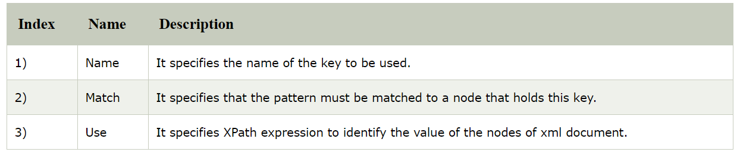
Parameter explanation

Slide 24
XSLT <xsl:message> Element
The XSLT <xsl:message> element is used to display the error message and help to debug the XSLT processing.
It is similar to JavaScript alerts. This element buffers a message to XSLT processor which terminates the processing and sends a message to the caller application to show an error message.
<xsl:message
terminate = "yes" | "no">
</xsl:message>

Slide 25
Parameter explanation
Terminate:
It specifies if the transformation should terminate upon executing this instruction or not. When the terminate attribute is set to "yes", the content of the element is displayed as the part of the system-level error message, and the transformation terminates. When it is set to "no", the transformation proceeds, ignoring the error message. By default value is ?no?.

Slide 26
XSLT <xsl:apply-template> Element
The XSLT <xsl:apply-template> element is used to tell XSLT processor to find the appropriate template to apply according to the type and context of each selected node.
<xsl:apply-template
select = Expression
mode = QName>
</xsl:apply-template>
Notes:
xsl:value-of uses the select attribute to choose elements. Because we are already at the correct element, student, we use a period "." to select the current element's data. The period is a special character to use when you want to select the same element that you matched with template's match attribute.

Slide 27
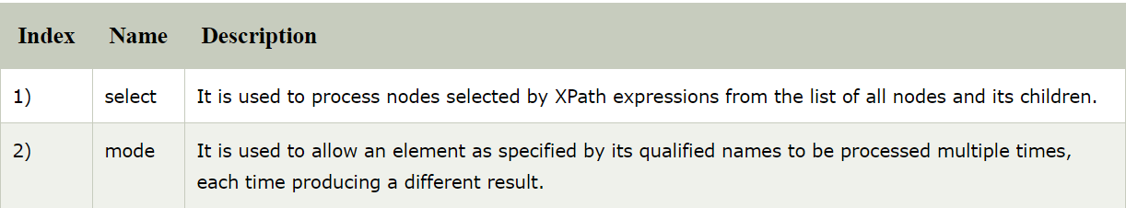
Parameter explanation

